Slide 1
Attend-In
Cameron Sumlin-Eskridge, Hard Thakkar, Eric Kelley, Nicole Grizzle, Steven Stewart

Slide 2
Completed Stories
Create a Timer
MD5 Hash Algorithm
Model-View-Controller
Object class model
Communicate with Prim’s API
Burndown Chart and Velocity Tracking

Slide 3
Backlog
Using IP address for log-in
Send geographical coordinates
Created timer for professor log-in screen

Slide 4
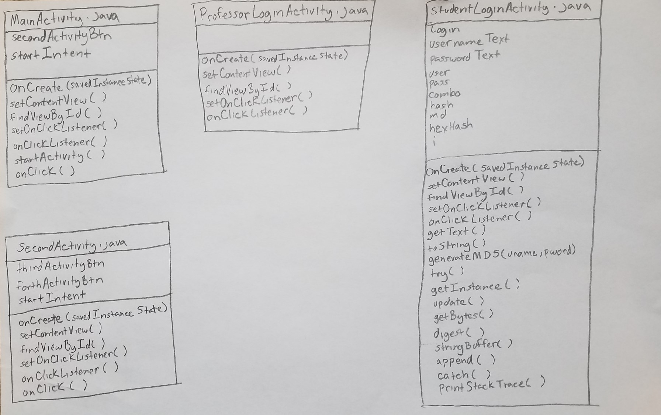
Object Class Model

Slide 5
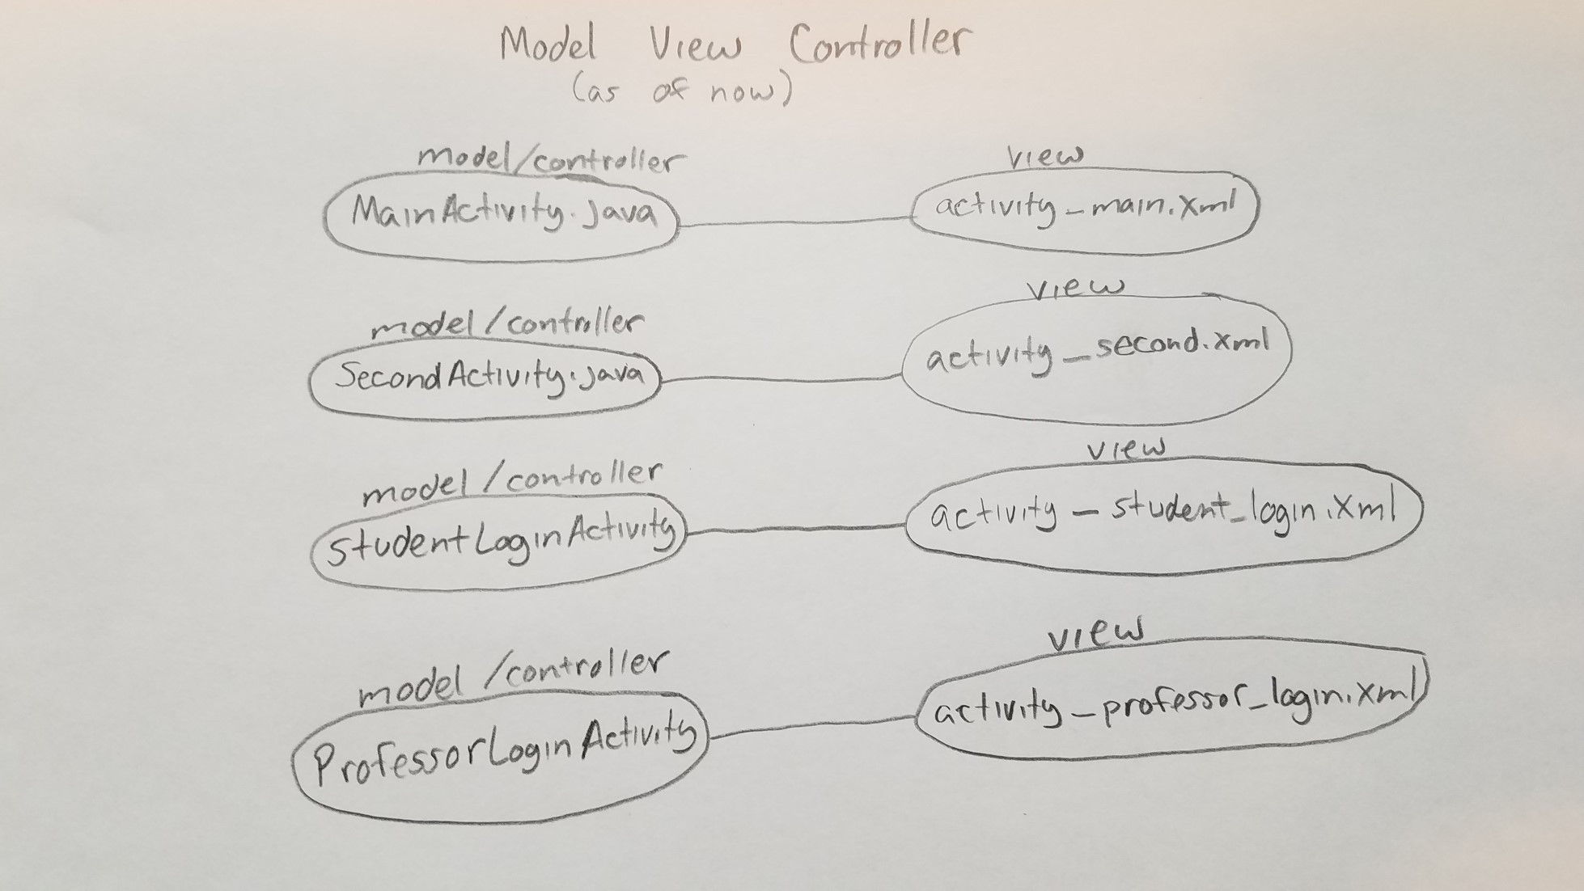
Model-View-Controller as of Oct 10th

Slide 6
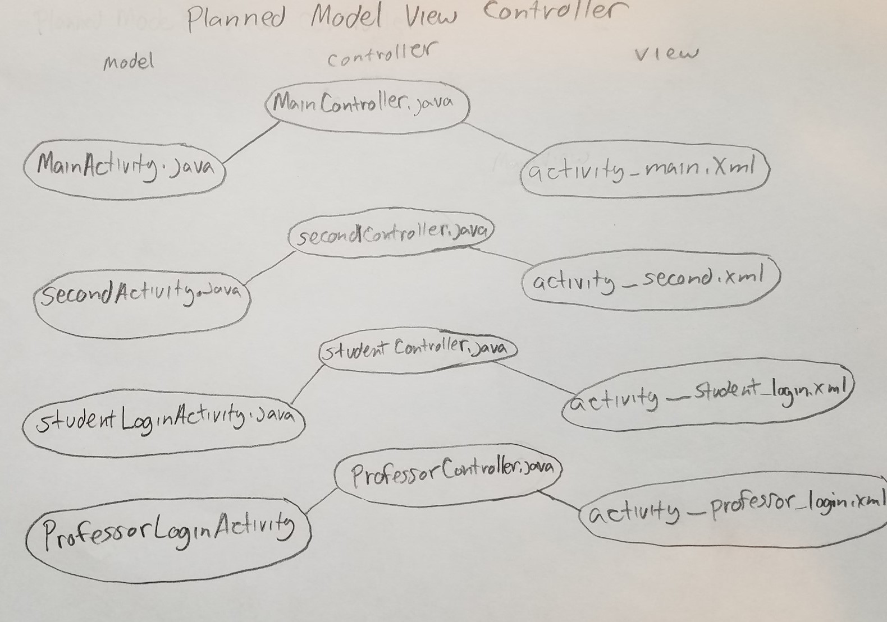
Planned Model-View-Controller

Slide 7
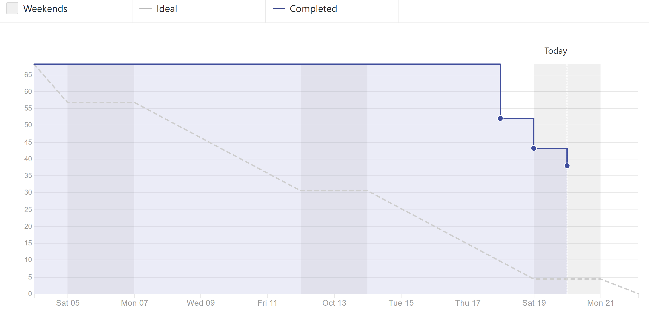
Burndown Chart

Slide 8
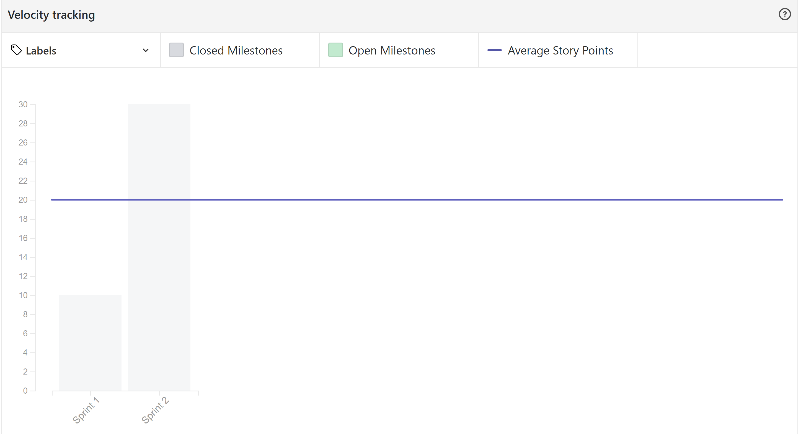
Velocity Tracking

Slide 9
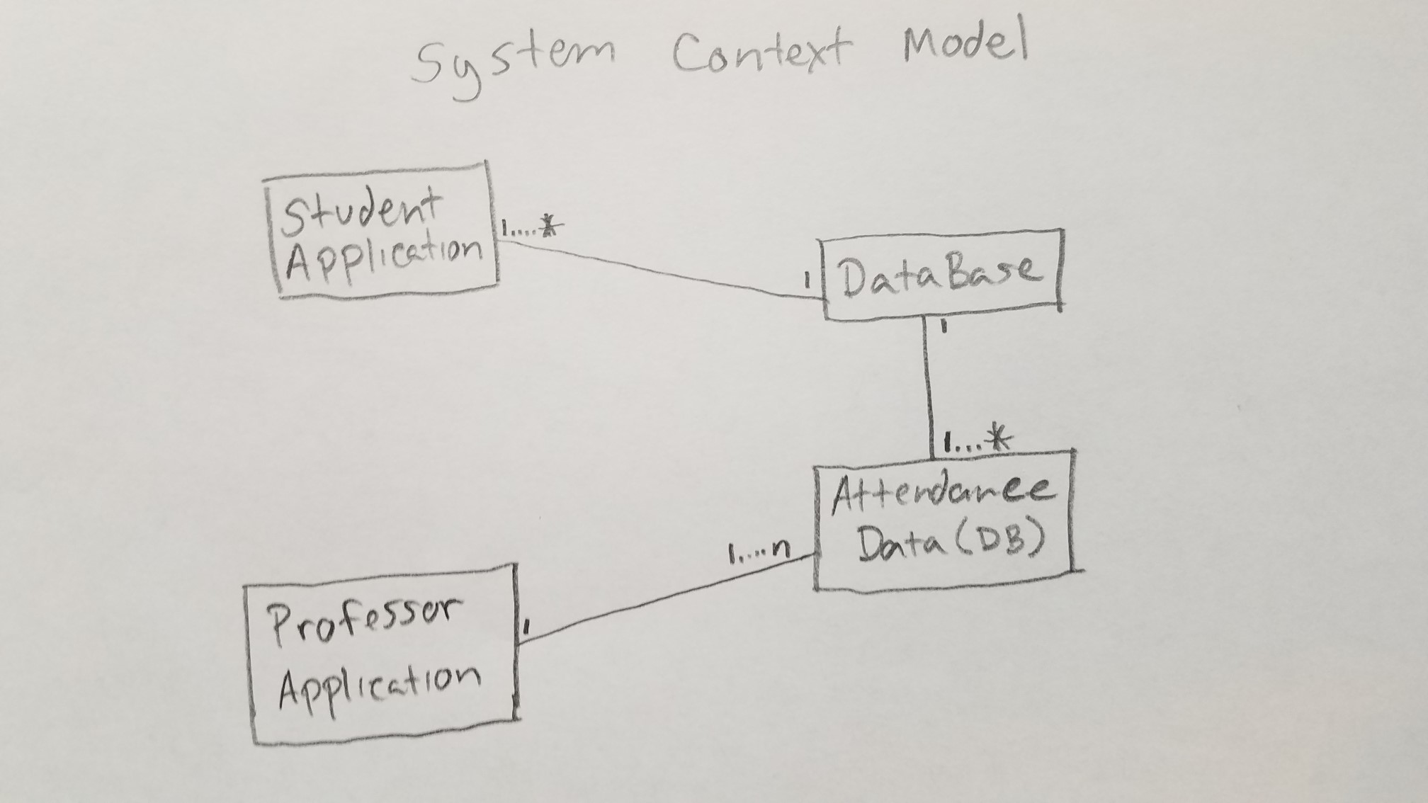
System Context Model

Slide 10
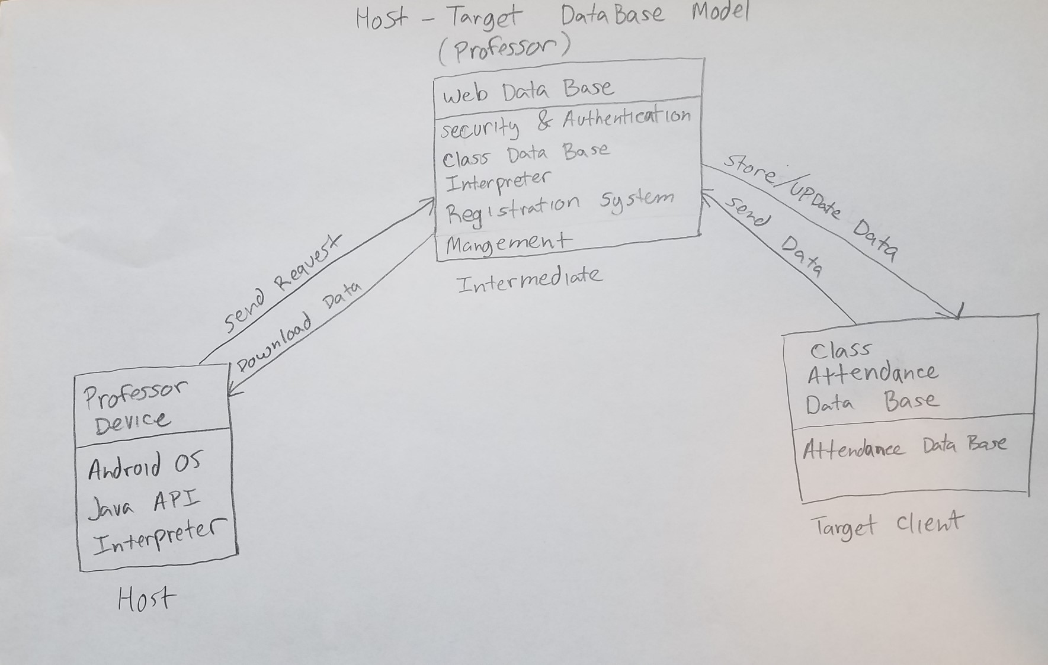
Professor Host Target Data base Model

Slide 11
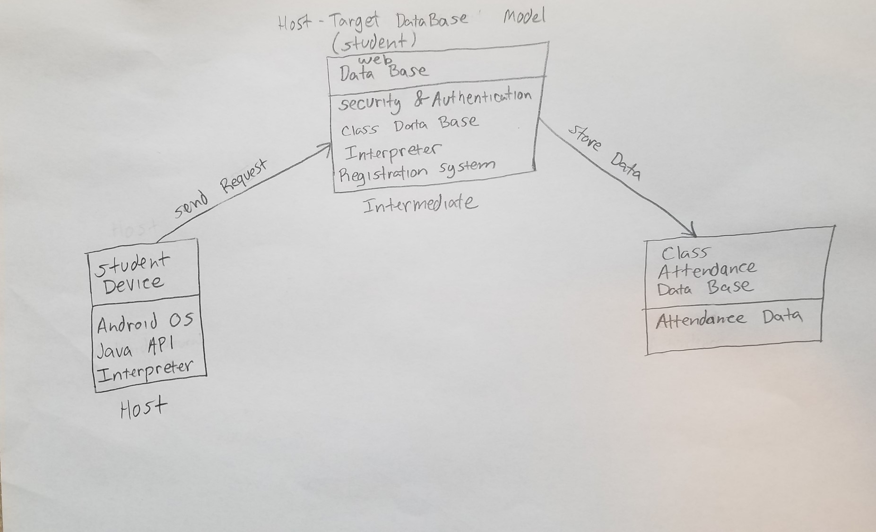
Student Host Target Data Base Model

Slide 12
Questions/Comments?

Slide 13
Thank You!

